Slide 1

Chapter 2
Application Layer
Computer Networking: A Top Down Approach
7th edition
Jim Kurose, Keith Ross
Pearson/Addison Wesley
April 2016
Application Layer
2-<number>

Slide 2
Chapter 2: application layer
our goals:
conceptual, implementation aspects of network application protocols
  transport-layer service models
  client-server paradigm
  peer-to-peer paradigm
  content distribution networks
learn about protocols by examining popular application-level protocols
  HTTP(hyper text transfer protocol)
  FTP (File transfer protocol)
  SMTP / POP3 / IMAP (Simple mail transfer protocol)
  DNS (domain name server)
Application Layer
2-<number>

Slide 3
Some network apps
e-mail
web
text messaging
remote login
P2P file sharing
multi-user network games
streaming stored video (YouTube, Hulu, Netflix)
voice over IP (e.g., Skype)
real-time video conferencing
social networking
search
…
…
Application Layer
2-<number>

Slide 4

















Creating a network app
application
transport
network
data link
physical
write programs that:
run on (different) end systems
communicate over network
e.g., web server software communicates with browser software
no need to write software for network-core devices
network-core devices do not run user applications
applications on end systems allows for rapid app development, propagation
application
transport
network
data link
physical
application
transport
network
data link
physical
Application Layer
2-<number>

Slide 5
Application architectures
possible structure of applications:
client-server
peer-to-peer (P2P)
Application Layer
2-<number>

Slide 6
Client-server architecture
server:
always-on host
permanent IP address
data centers for scaling
clients:
communicate with server
may be intermittently connected
may have dynamic IP addresses
do not communicate directly with each other
client/server
Application Layer
2-<number>

Slide 7
P2P architecture
no always-on server
arbitrary end systems directly communicate
peers request service from other peers, provide service in return to other peers
  self scalability – new peers bring new service capacity, as well as new service demands
peers are intermittently connected and change IP addresses
  complex management
peer-peer
Application Layer
2-<number>

Slide 8
Processes communicating
process: program running within a host
within same host, two processes communicate using inter-process communication (defined by OS)
processes in different hosts communicate by exchanging messages
clients, servers
client process: process that initiates communication
server process: process that waits to be contacted
aside: applications with P2P architectures have client processes & server processes
Application Layer
2-<number>

Slide 9
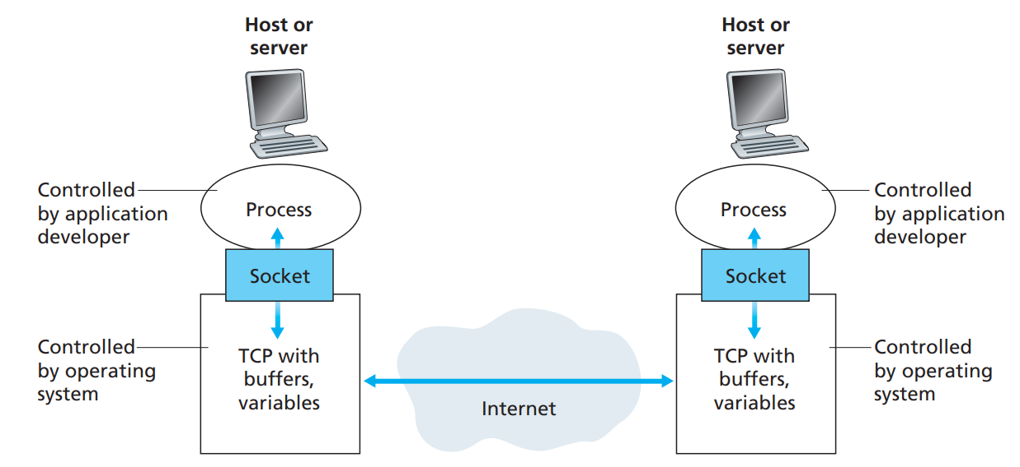
Sockets/ports
process sends/receives messages to/from its socket
socket analogous to door
  sending process shoves message out door
  sending process relies on transport infrastructure on other side of door to deliver message to socket at receiving process
Application Layer
2-<number>
Notes:
Both Socket and Port are the terms used in Transport Layer. ... An incoming packet has a port number which is used to identify the process that needs to consume the packet. The lowest numbered 1024 port numbers are used for the most commonly used services. These ports are called the well-known ports.
most applications consist of pairs of communicating processes, with the two processes in each pair sending messages to each other. Any message sent from one process to another must go through the underlying network. A process sends messages into, and receives messages from, the network through a software interface called a socket.

Slide 10
Addressing processes
to receive messages, process must have identifier
host device has unique 32-bit IP address
Q: does IP address of host on which process runs suffice for identifying the process?
identifier includes both IP address and port numbers associated with process on host.
example port numbers:
  HTTP server: 80
  mail server: 25
to send HTTP message to gaia.cs.umass.edu web server:
  IP address: 128.119.245.12
  port number: 80
more shortly…
  A: no, many processes can be running on same host
Application Layer
2-<number>

Slide 11
App-layer protocol defines
types of messages exchanged,
  e.g., request, response
message syntax:
  what fields in messages & how fields are delineated
message semantics
  meaning of information in fields
rules for when and how processes send & respond to messages
open protocols:
defined in RFCs
allows for interoperability
e.g., HTTP, SMTP
proprietary protocols:
e.g., Skype
Application Layer
2-<number>

Slide 12
What transport service does an app need?
data integrity
some apps (e.g., file transfer, web transactions) require 100% reliable data transfer
other apps (e.g., audio) can tolerate some loss
throughput
some apps (e.g., multimedia) require minimum amount of throughput to be “effective”
other apps (“elastic apps”) make use of whatever throughput they get
timing
some apps (e.g., Internet telephony, interactive games) require low delay to be “effective”
security
encryption, data integrity, …
Application Layer
2-<number>
Notes:
in the context
of a communication session between two processes along a network path, is
the rate at which the sending process can deliver bits to the receiving process.
Because other sessions will be sharing the bandwidth along the network path, and
because these other sessions will be coming and going, the available throughput
can fluctuate with time.
While bandwidth-sensitive applications have specific throughput requirements,
elastic applications can make use of as much, or as little, throughput
as happens to be available. Electronic mail, file transfer, and Web transfers are
all elastic applications. Of course, the more throughput, the better. There’s
an adage that says that one cannot be too rich, too thin, or have too much
throughput!
A transport-layer protocol can also provide timing guarantees. As with throughput guarantees, timing guarantees can come in many shapes and forms. An example guarantee might be that every bit that the sender pumps into the socket arrives at the receiver’s socket no more than 100 msec later. Such a service would be appealing to interactive real-time applications, such as Internet telephony, virtual environments, teleconferencing, and multiplayer games, all of which require tight timing con_x0002_straints on data delivery in order to be effective.

Slide 13
Transport service requirements: common apps
application
file transfer
e-mail
Web documents
real-time audio/video
stored audio/video
interactive games
text messaging
data loss
no loss
no loss
no loss
loss-tolerant
loss-tolerant
loss-tolerant
no loss
throughput
elastic
elastic
elastic
audio: 5kbps-1Mbps
video:10kbps-5Mbps
same as above
few kbps up
elastic
time sensitive
no
no
no
yes, 100’s msec
yes, few secs
yes, 100’s msec
yes and no
Application Layer
2-<number>

Slide 14
Internet apps: application, transport protocols
application
layer protocol
SMTP [RFC 2821]
Telnet [RFC 854]
HTTP [RFC 2616]
FTP [RFC 959]
HTTP (e.g., YouTube),
RTP [RFC 1889]
SIP, RTP, proprietary
(e.g., Skype)
underlying
transport protocol
TCP
TCP
TCP
TCP
TCP or UDP
TCP or UDP
application
e-mail
remote terminal access
Web
file transfer
streaming multimedia
Internet telephony
Application Layer
2-<number>

Slide 15
Chapter 2: outline
2.1 principles of network applications
2.2 Web and HTTP
2.3 electronic mail
  SMTP, POP3, IMAP
2.4 DNS
2.5 P2P applications
2.6 video streaming and content distribution networks
2.7 socket programming with UDP and TCP
Application Layer
2-<number>

Slide 16
Web and HTTP
First, a review…
web page consists of objects
object can be HTML file, JPEG image, audio file,…
web page consists of base HTML-file which includes several referenced objects
each object is addressable by a URL, e.g.,
www.someschool.edu/someDept/pic.gif
host name
path name
Application Layer
2-<number>

Slide 17


HTTP overview
HTTP: hypertext transfer protocol
Web’s application layer protocol
client/server model
  client: browser that requests, receives, (using HTTP protocol) and “displays” Web objects
  server: Web server sends (using HTTP protocol) objects in response to requests
HTTP request
PC running
Firefox browser
HTTP response
HTTP request
server
running
Apache Web
server
HTTP response
iPhone running
Safari browser
Application Layer
2-<number>

Slide 18
HTTP overview (continued)
uses TCP:
client initiates TCP connection (creates socket) to server, port 80
server accepts TCP connection from client
HTTP messages (application-layer protocol messages) exchanged between browser (HTTP client) and Web server (HTTP server)
TCP connection closed
HTTP is “stateless”
server maintains no information about past client requests
Application Layer
2-<number>

Slide 19
HTTP connections
non-persistent HTTP
at most one object sent over TCP connection
  connection then closed
downloading multiple objects required multiple connections
persistent HTTP
multiple objects can be sent over single TCP connection between client, server
Application Layer
2-<number>

Slide 20
Non-persistent HTTP
suppose user enters URL:
(contains text,
references to 10
jpeg images)
www.someSchool.edu/someDepartment/home.index
1a. HTTP client initiates TCP connection to HTTP server (process) at www.someSchool.edu on port 80
1b. HTTP server at host www.someSchool.edu waiting for TCP connection at port 80. “accepts” connection, notifying client
2. HTTP client sends HTTP request message (containing URL) into TCP connection socket. Message indicates that client wants object someDepartment/home.index
3. HTTP server receives request message, forms response message containing requested object, and sends message into its socket
time
Application Layer
2-<number>

Slide 21
Non-persistent HTTP (cont.)
4. HTTP server closes TCP connection.
5. HTTP client receives response message containing html file, displays html. Parsing html file, finds 10 referenced jpeg objects
time
6. Steps 1-5 repeated for each of 10 jpeg objects
Application Layer
2-<number>

Slide 22
Non-persistent HTTP: response time
RTT (definition): time for a small packet to travel from client to server and back
HTTP response time:
one RTT to initiate TCP connection
one RTT for HTTP request and first few bytes of HTTP response to return
file transmission time
non-persistent HTTP response time =
  2RTT+ file transmission time
initiate TCP
connection
RTT
request
file
RTT
time to
transmit
file
file
received
time
time
Application Layer
2-<number>
Notes:
Round time trip

Slide 23
Persistent HTTP
non-persistent HTTP issues:
requires 2 RTTs per object
OS overhead for each TCP connection
browsers often open parallel TCP connections to fetch referenced objects
persistent HTTP:
server leaves connection open after sending response
subsequent HTTP messages between same client/server sent over open connection
client sends requests as soon as it encounters a referenced object
as little as one RTT for all the referenced objects
Application Layer
2-<number>

Slide 24
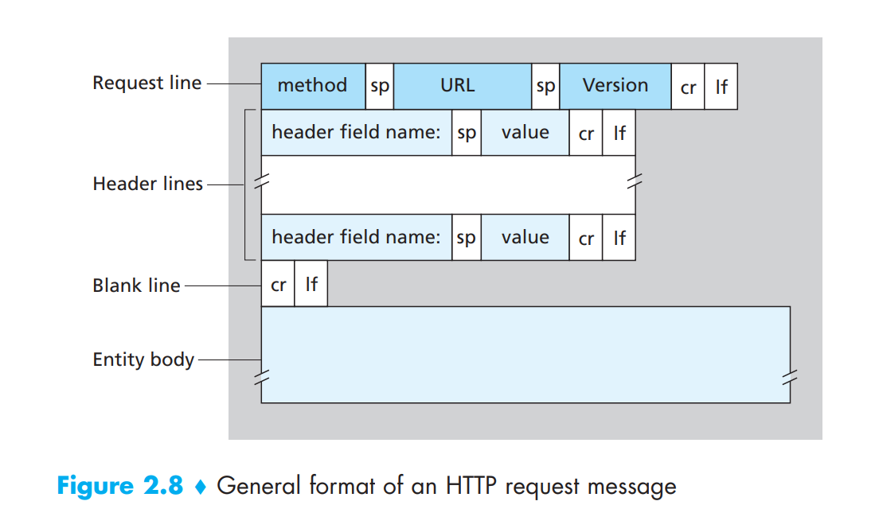
Application Layer
2-<number>
Notes:
d. The method field can take on several different values, including GET, POST, HEAD, PUT, and DELETE

Slide 25
HTTP Request Message
GET /somedir/page.html HTTP/1.1
Host: www.someschool.edu
Connection: close
User-agent: Mozilla/5.0
Accept-language: fr
Application Layer
2-<number>

Slide 26
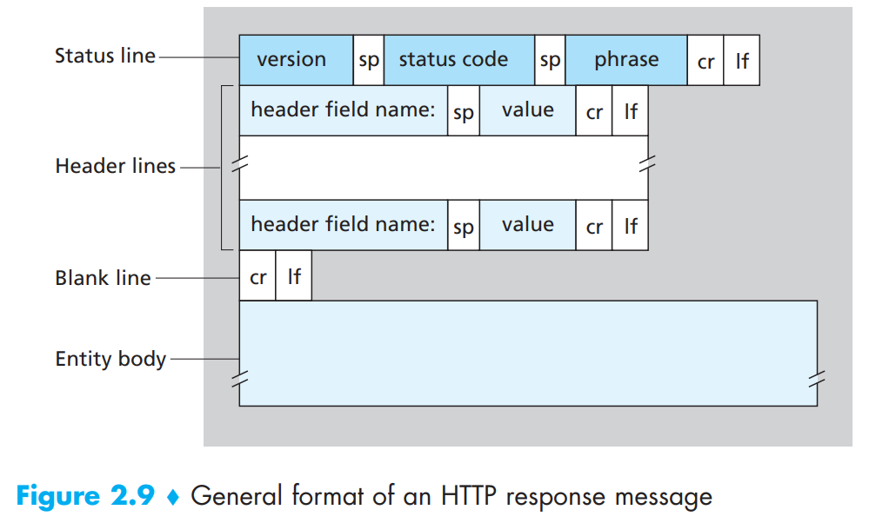
Application Layer
2-<number>

Slide 27
HTTP Response Message
HTTP/1.1 200 OK
Connection: close
Date: Tue, 09 Aug 2011 15:44:04 GMT
Server: Apache/2.2.3 (CentOS)
Last-Modified: Tue, 09 Aug 2011 15:11:03 GMT
Content-Length: 6821
Content-Type: text/html
(data data data data data ...)
Application Layer
2-<number>

Slide 28
User-server state: cookies
example:
Susan always access Internet from PC
visits specific e-commerce site for first time
when initial HTTP requests arrives at site, site creates:
  unique ID
  entry in backend database for ID
many Web sites use cookies
four components:
  1) cookie header line of HTTP response message
  2) cookie header line in next HTTP request message
  3) cookie file kept on user’s host, managed by user’s browser
  4) back-end database at Web site
Application Layer
2-<number>

Slide 29
Cookies: keeping “state” (cont.)
client
server
ebay 8734
usual http request msg
Amazon server
creates ID
1678 for user
cookie file
usual http response
set-cookie: 1678
backend
database
create
entry
ebay 8734
amazon 1678
usual http request msg
cookie: 1678
cookie-
specific
action
access
usual http response msg
one week later:
access
ebay 8734
amazon 1678
usual http request msg
cookie: 1678
cookie-
specific
action
usual http response msg
Application Layer
2-<number>

Slide 30
Cookies (continued)
aside
what cookies can be used for:
authorization
shopping carts
recommendations
user session state (Web e-mail)
cookies and privacy:
cookies permit sites to learn a lot about you
you may supply name and e-mail to sites
how to keep “state”:
protocol endpoints: maintain state at sender/receiver over multiple transactions
cookies: http messages carry state
Application Layer
2-<number>

Slide 31
Electronic mail
outgoing
message queue
user mailbox
Three major components:
user agents
mail servers
simple mail transfer protocol: SMTP
User Agent
a.k.a. “mail reader”
composing, editing, reading mail messages
e.g., Outlook, Thunderbird, iPhone mail client
outgoing, incoming messages stored on server
user
agent
mail
server
user
agent
SMTP
mail
server
user
agent
SMTP
SMTP
user
agent
mail
server
user
agent
user
agent
Application Layer
2-<number>

Slide 32
Electronic mail: mail servers
mail servers:
mailbox contains incoming messages for user
message queue of outgoing (to be sent) mail messages
SMTP protocol between mail servers to send email messages
  client: sending mail server
  “server”: receiving mail server
user
agent
mail
server
user
agent
SMTP
mail
server
user
agent
SMTP
SMTP
user
agent
mail
server
user
agent
user
agent
Application Layer
2-<number>
Notes:
Mail servers form the core of the e-mail infrastructure. Each recipient, such as
Bob, has a mailbox located in one of the mail servers. Bob’s mailbox manages and
maintains the messages that have been sent to him. A typical message starts its journey
in the sender’s user agent, travels to the sender’s mail server, and
travels to the recipient’s mail server, where it is deposited in the recipient’s mailbox

Slide 33
Electronic Mail: SMTP [RFC 2821]
uses TCP to reliably transfer email message from client to server, port 25
direct transfer: sending server to receiving server
three phases of transfer
  handshaking (greeting)
  transfer of messages
  closure
command/response interaction (like HTTP)
  commands: ASCII text (7- bit ASCII )
  response: status code and phrase
messages must be in 7-bit ASCI
Application Layer
2-<number>

Slide 34


Scenario: Alice sends message to Bob
1) Alice uses UA to compose message “to” bob@someschool.edu
2) Alice’s UA sends message to her mail server; message placed in message queue
3) client side of SMTP opens TCP connection with Bob’s mail server
4) SMTP client sends Alice’s message over the TCP connection
5) Bob’s mail server places the message in Bob’s mailbox
6) Bob invokes his user agent to read message
user
agent
mail
server
user
agent
1
mail
server
2
3
6
4
Alice’s mail server
5
Bob’s mail server
Application Layer
2-<number>

Slide 35
Sample SMTP interaction
S: 220 hamburger.edu
C: HELO crepes.fr
S: 250 Hello crepes.fr, pleased to meet you
C: MAIL FROM: <alice@crepes.fr>
S: 250 alice@crepes.fr... Sender ok
C: RCPT TO: <bob@hamburger.edu>
S: 250 bob@hamburger.edu ... Recipient ok
C: DATA
S: 354 Enter mail, end with "." on a line by itself
C: Do you like ketchup?
C: How about pickles?
C: .
S: 250 Message accepted for delivery
C: QUIT
S: 221 hamburger.edu closing connection
Application Layer
2-<number>
Notes:
The server is ready.
250 Its typical side message is “Requested mail action okay completed”: meaning that the server has transmitted a message.
354The server has received the “From” and “To” details of the email, and is ready to get the body message. It’s the typical response to the DATA command.
221The server is closing its transmission channel. It can come with side messages like “Goodbye” or “Closing connection”.

Slide 36
Try SMTP interaction for yourself:
telnet servername 25
see 220 reply from server
enter HELO, MAIL FROM, RCPT TO, DATA, QUIT commands
above lets you send email without using email client (reader)
Application Layer
2-<number>

Slide 37
SMTP: final words
SMTP uses persistent connections
SMTP requires message (header & body) to be in 7-bit ASCII
SMTP server uses CRLF.CRLF to determine end of message
comparison with HTTP:
HTTP: pull
SMTP: push
both have ASCII command/response interaction, status codes
HTTP: each object encapsulated in its own response message
SMTP: multiple objects sent in multipart message
Application Layer
2-<number>
Notes:
First,
HTTP is mainly a pull protocol—someone loads information on a Web server and
users use HTTP to pull the information from the server at their convenience. In particular,
the TCP connection is initiated by the machine that wants to receive the file.
On the other hand, SMTP is primarily a push protocol—the sending mail server
pushes the file to the receiving mail server. In particular, the TCP connection is initiated
by the machine that wants to send the file.

Slide 38
Mail message format
SMTP: protocol for exchanging email messages
RFC 822: standard for text message format:
header lines, e.g.,
  To:
  From:
  Subject:
  different from SMTP MAIL FROM, RCPT TO: commands!
Body: the “message”
  ASCII characters only
header
blank
line
body
Application Layer
2-<number>

Slide 39
Mail access protocols
user
agent
mail access
protocol
user
agent
SMTP
SMTP
(e.g., POP,
IMAP)
sender’s mail
server
receiver’s mail
server
SMTP: delivery/storage to receiver’s server
mail access protocol: retrieval from server
  POP: Post Office Protocol [RFC 1939]: authorization, download
  IMAP: Internet Mail Access Protocol [RFC 1730]: more features, including manipulation of stored messages on server
  HTTP: gmail, Hotmail, Yahoo! Mail, etc.
Application Layer
2-<number>

Slide 40
Mail access protocols (cont.)
SMTP is used to transfer mail from the sender’s mail server to the recipient’s mail server;
SMTP is also used to transfer mail from the sender’s user agent to the sender’s mail server.
A mail access protocol, such as POP3, is used to transfer mail from the recipient’s mail server to the recipient’s user agent.
Application Layer
2-<number>

Slide 41
POP3 protocol
S: +OK POP3 server ready
C: user bob
S: +OK
C: pass hungry
S: +OK user successfully logged on
authorization phase
client commands:
  user: declare username
  pass: password
server responses
  +OK
  -ERR
transaction phase, client:
list: list message numbers
retr: retrieve message by number
dele: delete
quit
C: list
S: 1 498
S: 2 912
S: .
C: retr 1
S: <message 1 contents>
S: .
C: dele 1
C: retr 2
S: <message 1 contents>
S: .
C: dele 2
C: quit
S: +OK POP3 server signing off
Application Layer
2-<number>

Slide 42
POP3 (more) and IMAP
more about POP3
previous example uses POP3 “download and delete” mode
  Bob cannot re-read e-mail if he changes client
POP3 “download-and-keep”: copies of messages on different clients
POP3 is stateless across sessions
IMAP(internet mail access protocol)
keeps all messages in one place: at server
allows user to organize messages in folders
keeps user state across sessions:
  names of folders and mappings between message IDs and folder name
Application Layer
2-<number>

Slide 43
DNS: domain name system
people: many identifiers:
  SSN, name, passport #
Internet hosts, routers:
  IP address (32 bit) - used for addressing datagrams
  “name”, e.g., www.yahoo.com - used by humans
Q: how to map between IP address and name, and vice versa ?
Domain Name System:
distributed database implemented in hierarchy of many name servers
application-layer protocol: hosts, name servers communicate to resolve names (address/name translation)
  note: core Internet function, implemented as application-layer protocol
  complexity at network’s “edge”
The DNS protocol runs over UDP and uses port 53.
Application Layer
2-<number>

Slide 44
DNS: services, structure
DNS services
hostname to IP address translation
host aliasing
  canonical, alias names
mail server aliasing
load distribution
  replicated Web servers: many IP addresses correspond to one name
why not centralize DNS?
single point of failure
traffic volume
distant centralized database
maintenance
A: doesn‘t scale!
Application Layer
2-<number>

Slide 45
DNS: a distributed, hierarchical database
Root DNS Servers
…
…
com DNS servers
org DNS servers
edu DNS servers
yahoo.com
DNS servers
pbs.org
DNS servers
poly.edu
DNS servers
umass.edu
DNS servers
amazon.com
DNS servers
client wants IP for www.amazon.com; 1st approximation:
client queries root server to find com DNS server
client queries .com DNS server to get amazon.com DNS server
client queries amazon.com DNS server to get IP address for www.amazon.com
Application Layer
2-<number>
Notes:
Root servers
Top level servers
Authoritative servers

Slide 46

DNS: root name servers
contacted by local name server that can not resolve name
root name server:
  contacts authoritative name server if name mapping not known
  gets mapping
  returns mapping to local name server
c. Cogent, Herndon, VA (5 other sites)
d. U Maryland College Park, MD
h. ARL Aberdeen, MD
j. Verisign, Dulles VA (69 other sites )
k. RIPE London (17 other sites)
i. Netnod, Stockholm (37 other sites)
e. NASA Mt View, CA
f. Internet Software C.
Palo Alto, CA (and 48 other sites)
m. WIDE Tokyo
(5 other sites)
13 logical root name “servers” worldwide
each “server” replicated many times
a. Verisign, Los Angeles CA
(5 other sites)
b. USC-ISI Marina del Rey, CA
l. ICANN Los Angeles, CA
(41 other sites)
g. US DoD Columbus, OH (5 other sites)
Application Layer
2-<number>

Slide 47
TLD, authoritative servers
top-level domain (TLD) servers:
  responsible for com, org, net, edu, aero, jobs, museums, and all top-level country domains, e.g.: uk, fr, ca, jp
  Network Solutions maintains servers for .com TLD
  Educause for .edu TLD
authoritative DNS servers:
  organization’s own DNS server(s), providing authoritative hostname to IP mappings for organization’s named hosts
  can be maintained by organization or service provider
Application Layer
2-<number>

Slide 48
Local DNS name server
does not strictly belong to hierarchy
each ISP (residential ISP, company, university) has one
  also called “default name server”
when host makes DNS query, query is sent to its local DNS server
  has local cache of recent name-to-address translation pairs (but may be out of date!)
  acts as proxy, forwards query into hierarchy
Application Layer
2-<number>

Slide 49
Pure P2P architecture
no always-on server
arbitrary end systems directly communicate
peers are intermittently connected and change IP addresses
examples:
  file distribution (BitTorrent)
  Streaming (KanKan)
  VoIP (Skype)
Application Layer
2-<number>

Slide 50

P2P file distribution: BitTorrent
file divided into 256Kb chunks
peers in torrent send/receive file chunks
tracker: tracks peers
participating in torrent
torrent: group of peers exchanging chunks of a file
Alice arrives …
… obtains list
of peers from tracker
… and begins exchanging
file chunks with peers in torrent
Application Layer
2-<number>

Slide 51


P2P file distribution: BitTorrent
peer joining torrent:
  has no chunks, but will accumulate them over time from other peers
  registers with tracker to get list of peers, connects to subset of peers (“neighbors”)
while downloading, peer uploads chunks to other peers
peer may change peers with whom it exchanges chunks
churn: peers may come and go
once peer has entire file, it may (selfishly) leave or (altruistically) remain in torrent
Application Layer
2-<number>

Slide 52
BitTorrent: requesting, sending file chunks
requesting chunks:
at any given time, different peers have different subsets of file chunks
periodically, Alice asks each peer for list of chunks that they have
Alice requests missing chunks from peers, rarest first
sending chunks: tit-for-tat
Alice sends chunks to those four peers currently sending her chunks at highest rate
  other peers are choked by Alice (do not receive chunks from her)
  re-evaluate top 4 every10 secs
every 30 secs: randomly select another peer, starts sending chunks
  “optimistically unchoke” this peer
  newly chosen peer may join top 4
Application Layer
2-<number>

Slide 53
BitTorrent: tit-for-tat
(1) Alice “optimistically unchokes” Bob
(2) Alice becomes one of Bob’s top-four providers; Bob reciprocates
(3) Bob becomes one of Alice’s top-four providers
higher upload rate: find better trading partners, get file faster !
Application Layer
2-<number>

